Slide 1
Divide and Conquer Algorithms
Part II
Jorge A. Cobb
The University of Texas at Dallas

Slide 2
Multiplication of integers
a = (a_{n-1}a_{n-2}...a₀)₂, b= (b_{n-1}b_{n-2}...b₀)₂
Add the following partial products
  For each position j from 0 to n-1
    If a_{j} = 1, add b shifted j bits to the left
How many shifts?
  0 + 1 + 2 + ... + n-1 = O(n²)
How many bit additions?
  n additions of numbers no longer than n bits, total O(n²)
Overall total O(n²)

Slide 3
Recursive multiplication of integers
This algorithm splits each of two n-bit integers into two n/2 bits blocks (n is a power of 2)
It is reduced to only three multiplications of n/2 bit integers, plus shifts and additions
To find the product ab of two n-bit numbers,
a = (a_{n-1}, a_{n-2} , … , a₀)₂ and
b = (b_{n-1}, b_{n-2} , … , b₀)₂,
first, we “break them” in half:
a = 2^{n/2}A₁ + A₀, b = 2^{n/2}B₁ + B₀,

Slide 4
Recursive multiplication of integers …
ab = (2^{n/2}A₁ + A₀)(2^{n/2}B₁ + B₀)
= 2^{n/2}2^{n/2}A₁B₁ + 2^{n/2}(A₁B₀ + B₁A₀) + A₀B₀
Thus we could solve the problem in time
  f(n) = 4f(n/2) + c₁n
Note that we use all 4 overlapping combinations of the two subproblems

Slide 5
Recursive (Faster) multiplication of integers …
Observe that (A₁ – A₀)(B₀ – B₁) =
A₁B₀ + B₁A₀ – A₁B₁ – A₀B₀
ab = (2^{n/2}A₁ + A₀)(2^{n/2}B₁ + B₀) =
= 2^{n}A₁B₁ + 2^{n/2}(A₁B₀ + B₁A₀) + A₀B₀
= 2^{n}A₁B₁ + 2^{n/2}((A₁ – A₀)(B₀ – B₁) + A₁B₁ + A₀B₀)
+ A₀B₀
= (2^{n} + 2^{n/2})A₁B₁ + 2^{n/2}(A₁ – A₀)(B₀ – B₁)
+ (2^{n/2} + 1)A₀B₀
f(n) = 3f(n/2) + c₂n

Slide 6
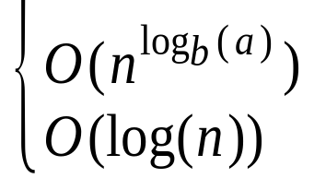
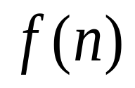
Theorem1
Let f(n) = af(n/b) + c whenever n is divisible by b, where a≥1, b is an integer greater than 1, and c is a positive real number. Then
if a > 1
if a = 1
Furthermore, when n = b^{k}, where k is a positive integer,
f(n) = f(1) + ck if a = 1
f(n) = C₁n^{logba} + C₂ if a > 1
where C₁ = f(1) + c/(a - 1), C₂ = - c/(a - 1)
is

Slide 7
Proving Theorem 1
If n=b^{k} for some k (k = log_{b}n),
f(n) = af(n/b) + c
= a(af(n/b²) + c) + c
= a²f(n/b²) + ac + c
= a²(f(n/b³) + c) + ac + c
= a³f(n/b³) + a²c + ac + c = ... = = a^{k}f(1) + c(1+ a + a² + ... +a^{k-1})
Assume a=1 and that n=b^{k}. Then, a^{k} = 1 and the sum is ck, so that
f(n) = f(1) + ck = f(1) + clog_{b}n = O(logn).

Slide 8
Proving Theorem 1
If a=1 but n is not a power of b, there is some k such that b^{k} < n < b^{k+1}.
Because f is increasing, f(b^{k}) ≤ f(n) ≤ f(b^{k+1}).
f(n) ≤ f(b^{k+1})
= f(1) + c(k+1)
= f(1) + c + ck
< f(1) + c + clog_{b}n since k < log_{b}n.
So f(n) is again O(logn).

Slide 9
Proving Theorem 1
Now consider a>1 and first the case where n=b^{k} for some k.
The sum is c(a^{k}-1)/(a-1) (sum of the terms of a geometric progression), so
f(n) = a^{k}f(1) + c(a^{k}-1)/(a-1)
= (f(1)+c/(a-1))a^{k} – c/(a-1)
= (f(1)+c/(a-1))n^{logba} – c/(a-1)
= O(n^{logba}).
The proof for the remaining case is similar to the previous part of the proof, using the next higher k.

Slide 10
Applying Theorem 1
Binary search
  f(n)=f(n/2)+2 (a = 1)
  O(logn)
Finding the minimum and maximum
  f(n)=2f(n/2)+2 (a > 1)
  O(n^{log22}) = O(n¹) = O(n)

Slide 11
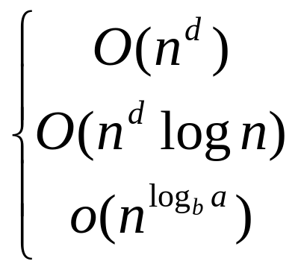
MASTER Theorem
Let f(n) = af(n/b) + cn^{d} whenever
n = b^{k},
a ≥ 1,
b > 1,
c > 0,
d ≥ 0,
  if a < b^{d}
  f(n) is if a = b^{d}
  if a > b^{d}

Slide 12
Applying Theorem 2
Merge sort
  f(n) = 2f(n/2) + cn
  a=2, b=2, d=1
  b^{d} = 2¹ = 2 = a
  O(n¹logn) = O(nlogn)

Slide 13
Multiplication complexity
Classical
  O(n²)
Recursive
  f(n) = 4f(n/2) + c₁n
  a = 4, b = 2, d = 1
  a > b^{d} so O(n^{logba}) = O(n^{log24}) = O(n²)
Faster
  f(n) = 3f(n/2) + c₂n
  a = 3, b = 2, d = 1
  a > b^{d} so O(n^{logba}) = O(n^{log23}) ≈ O(n^{1.6})

